Slide 1
Evidence QA
COURSE PROJECT
Evidence-Grounded Lecture Video Question Answering with Timestamp-Level Support
SRIJITH R | 24MID0009
Under the guidance of Dr. DURGESH KUMAR Assistant Professor Sr. Grade 1
MDI3003 – Advanced Predictive Analytics Theory Component Course Project
03rd November 2026

Slide 2
Why this project?
Finding one explanation in a long lecture can take too much time.
Students replay or scrub through videos to find a specific topic.
Ordinary question-answering tools may not show the source of an answer.
Learners need evidence they can check against the original lecture.
Our idea
Ask a question ↓ Find evidence ↓ Answer with timestamps ↓ Verify in the video

Slide 3
Problem statement and gap
Problem statement
Given a lecture and a learner’s question, retrieve relevant transcript passages and provide an answer with timestamps that allow the learner to verify the source.
Practical gap this prototype targets
Connect answers to specific points in a lecture.
Show the transcript evidence instead of hiding the source.
Avoid guessing when the transcript does not contain enough evidence.
Scope: lecture question answering and timestamped retrieval are existing research areas. This project implements and evaluates an integrated workflow; it does not claim the overall problem is new.

Slide 4
Objectives
Accept local lecture media, supported YouTube URLs, and transcript inputs.
Convert speech to text or import an existing transcript.
Keep transcript segments linked to timestamps.
Retrieve passages relevant to a user’s question.
Display source excerpts and timestamp references.
Abstain when the available evidence is insufficient.
Main design principle
Answers should be inspectable, not just readable.

Slide 5
System architecture
Lecture input
Video / audio / URL / transcript
Whisper speech recognition
Timestamped transcript segments
Question-based evidence retrieval
Answer + excerpts
+ timestamps
Relevance threshold and abstention
The transcript is the evidence source. Users can inspect passages and verify them against the original recording.

Slide 6
Algorithms and models used
Component
Model / technique
Purpose
Speech recognition
Whisper via faster-whisper
Pretrained deep-learning Transformer converts speech into text with segment timing.
Organizes transcript into timestamped passages.
Finds passages related to the question.
Presents responses based on retrieved transcript excerpts.
Declines when no passage meets the con-figured threshold.
Transcript prepara-
Text normalization and seg-mentation
Text relevance scoring and ranking
Retrieval-grounded response construction
Relevance threshold and ab-stention
tion
Evidence retrieval
Answering Evidence gate
Describe the retrieval score by its exact implementation in the current source code. Do not claim BERT, GPT, Random Forest,
or a trained QA model unless it is actually implemented.

Slide 7
Deep-learning model: Whisper
Whisper’s role
A pretrained encoder–decoder Transformer for automatic speech recognition.
Converts lecture audio into text.
Provides time-aligned segments for the transcript interface.
faster-whisper is an optimized implementation for running Whisper.
Processing path
Audio ↓ Whisper inference ↓ Text + timestamps ↓ Evidence index
Model choice: tiny is faster; base or larger models may improve recognition but need more time and resources.

Slide 8
How evidence-based answering works
The learner enters a question about the selected lecture.
The application scores transcript segments for relevance to the question.
The highest-ranked passages are selected.
A minimum relevance threshold filters weak matches.
The application shows the answer, excerpts, timestamps, and source links when available.
Important distinction
A relevance score ranks candidate passages. It is not a calibrated probability that an answer is correct.

Slide 9
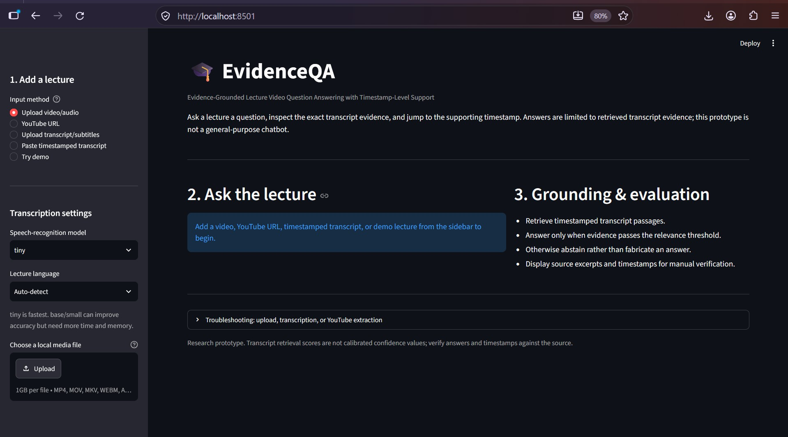
Application overview
The Streamlit interface
brings lecture input, question answering, transcript preview, and evidence inspection into one workflow.

Slide 10
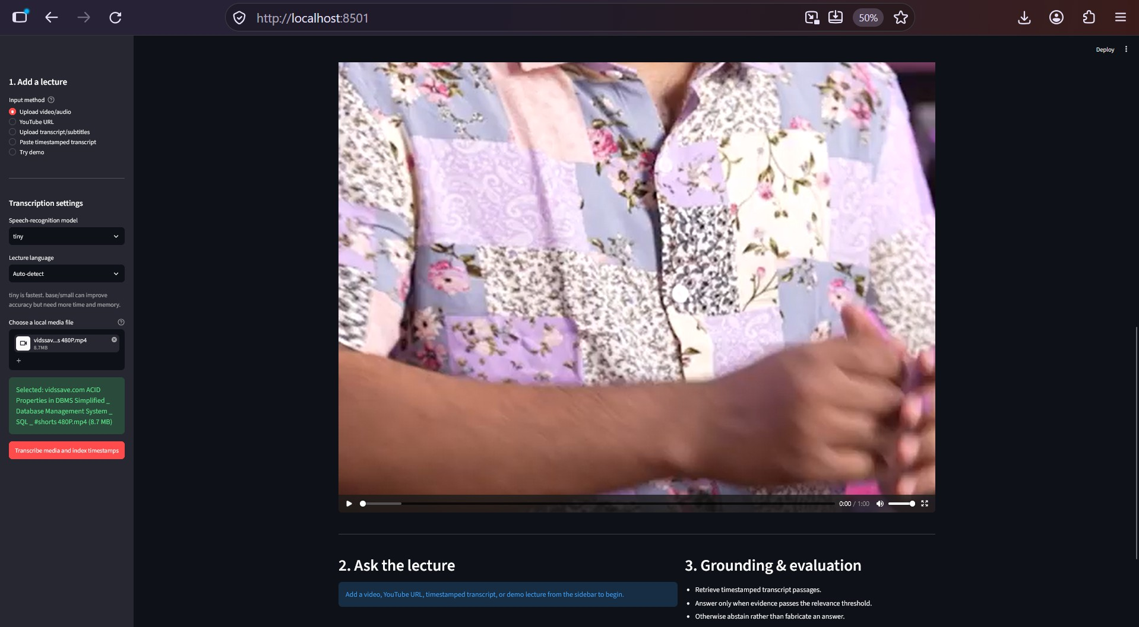
Lecture upload and video playback
A local video can be
selected and viewed before transcription. Supported formats depend on the installed media-decoding libraries.

Slide 11
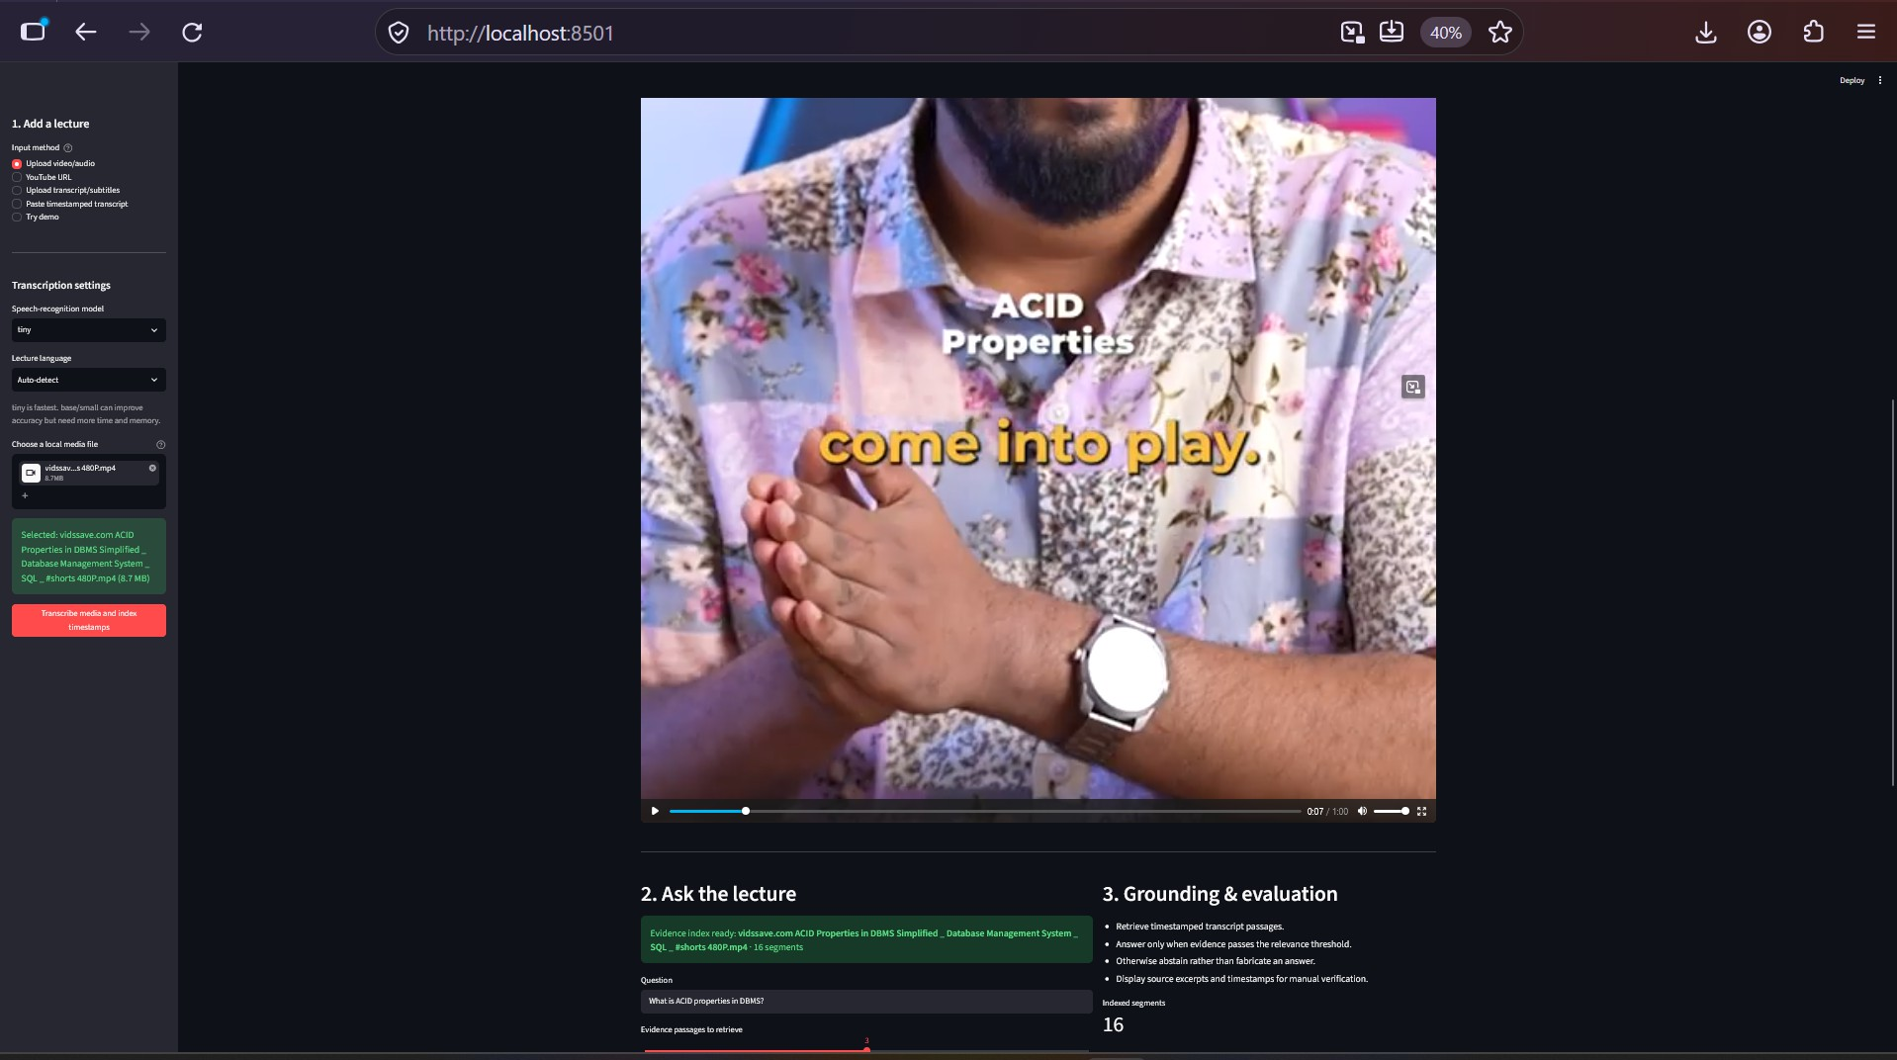
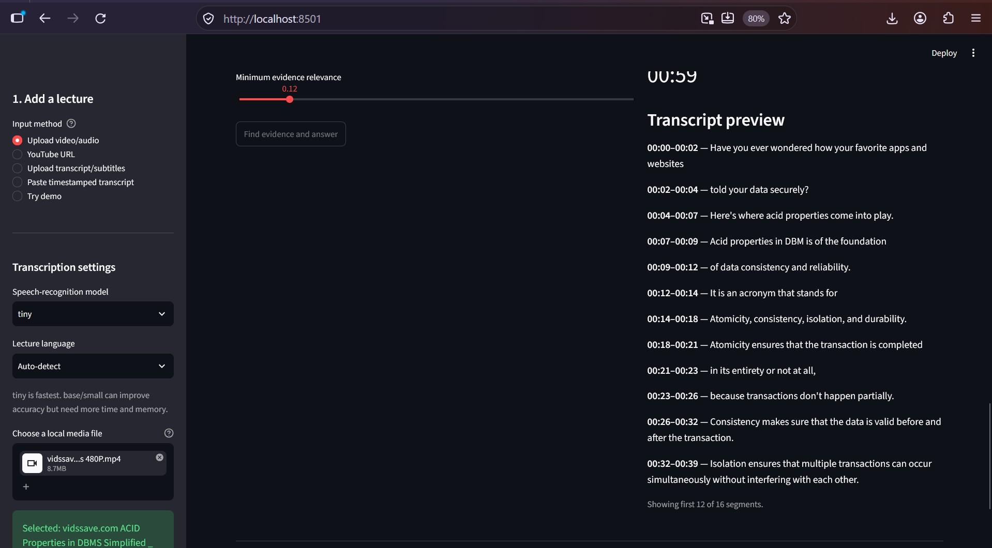
Transcription and timestamped transcript
Transcription workflow
Transcript preview

Slide 12
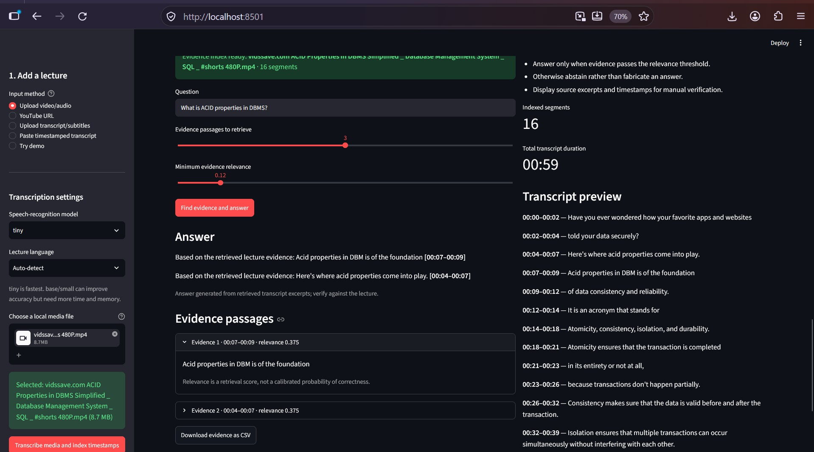
Question answering with visible evidence
What to inspect
Question and answer
Supporting transcript excerpts
Start/end timestamps
Source-video verification link
Use a question actually answered in the selected lecture and manually check that each cited segment supports the response.

Slide 13
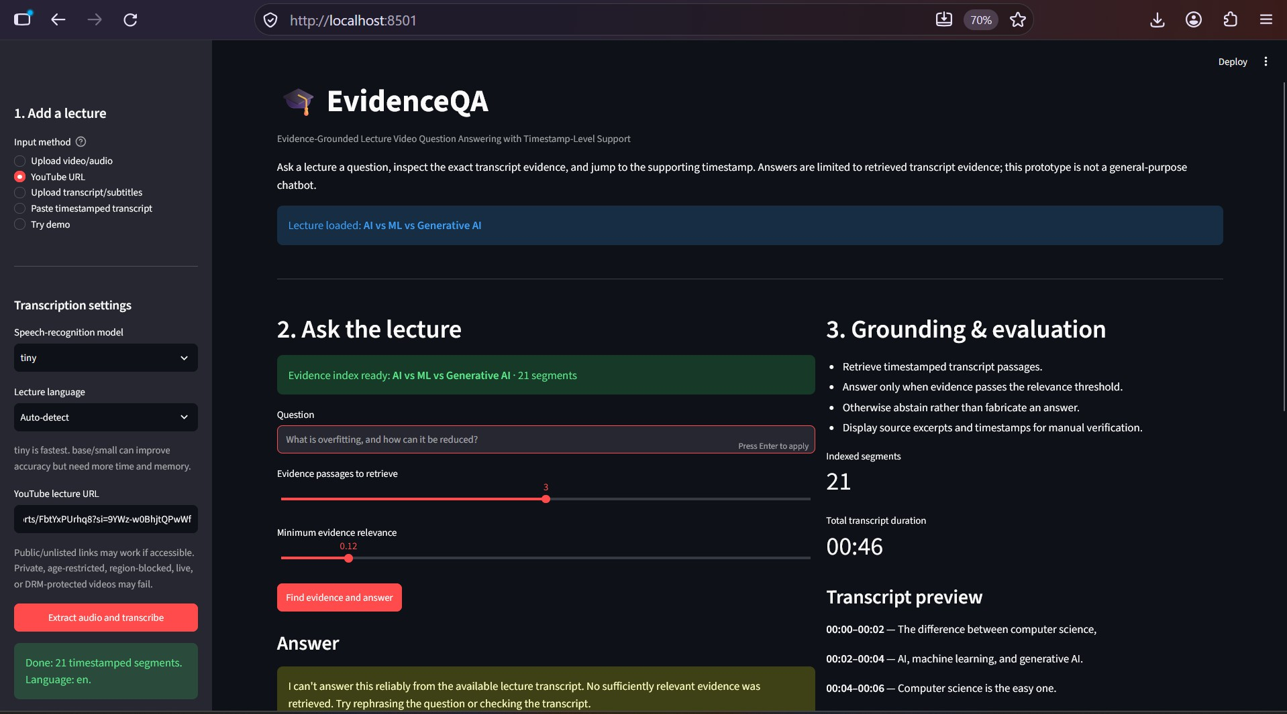
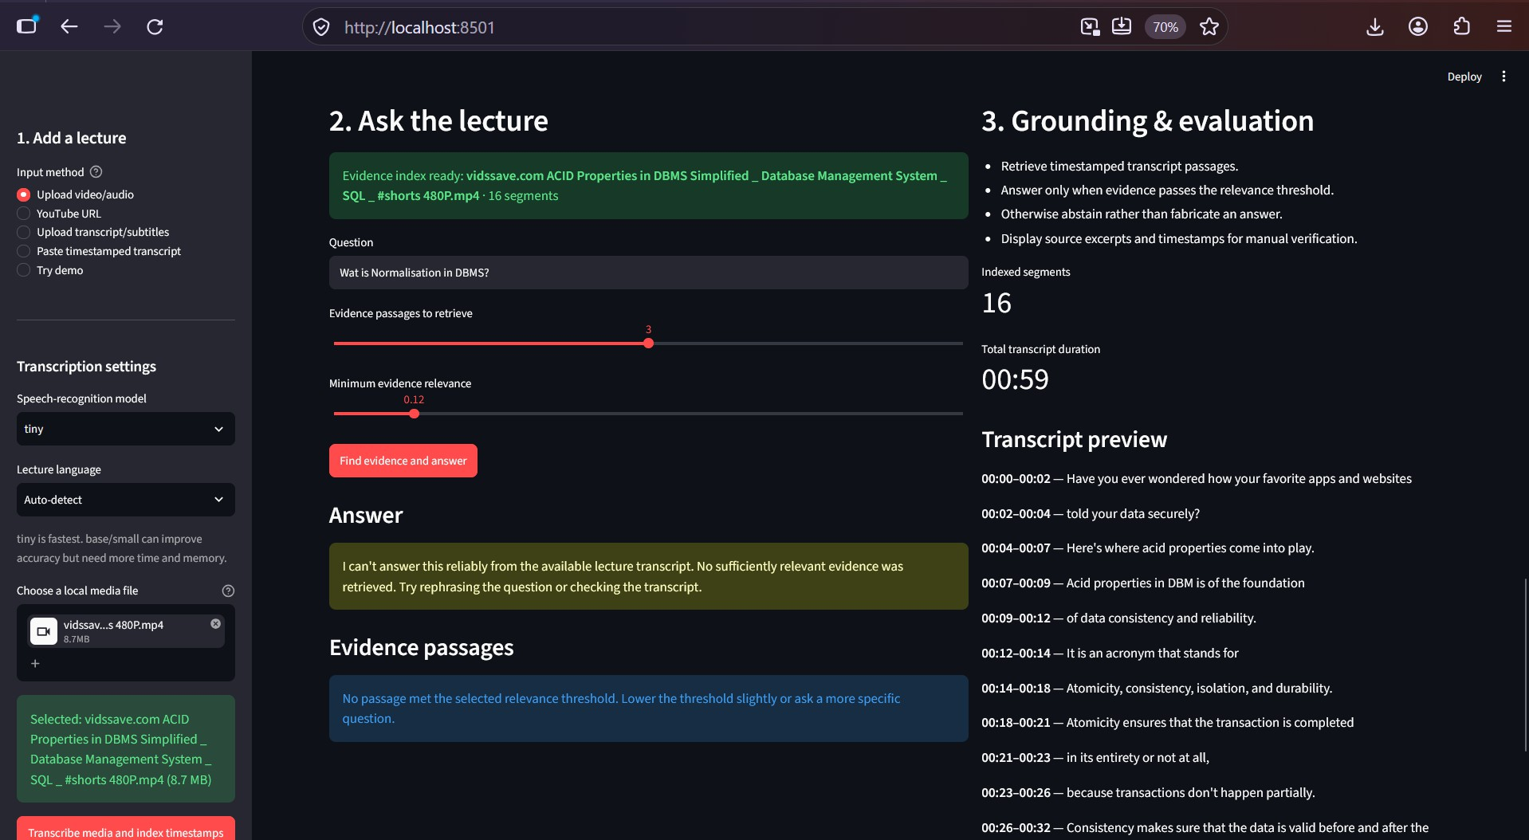
YouTube support and abstention
YouTube extraction
Insufficient evidence
Extraction depends on video accessibility and network/platform restrictions.
If evidence is weak, the application should say it cannot answer reliably instead of guessing.

Slide 14
Evaluation plan
How to evaluate the prototype fairly
Create a question set across several lecture videos.
Manually label the expected answer and supporting timestamps.
Measure retrieval with Precision@k, Recall@k, and MRR or nDCG.
Review answer support as supported, partially supported, or unsupported.
Test questions whose answers are absent and measure abstention behaviour.
Audit a sample of generated transcripts against reference transcripts.
Current evidence status
Screenshots demonstrate interface behaviour. They are not, by themselves, proof of accuracy or general research performance.

Slide 15
Limitations and next steps
Limitations
Speech recognition can mishear technical terms.
Relevant-looking passages can still be wrong.
Retrieval scores are not calibrated confidence values.
Some YouTube videos cannot be extracted.
Next steps
Test with a documented lecture/question dataset.
Verify every answer and timestamp manually.
Report retrieval and answer-support metrics.
Analyse failures before changing the method.
Use recordings you are permitted to process and clearly separate demonstration results from measured experimental findings.

Slide 16
Conclusion and references
Takeaway
EvidenceQA combines pretrained Whisper speech recognition, timestamped transcript segments, question-driven passage retrieval, and threshold-based abstention. Its focus is to make lecture answers easier to inspect and verify.
Selected references
Radford et al. (2023). Robust Speech Recognition via Large-Scale Weak Supervision. ICML.
SYSTRAN. faster-whisper. https://github.com/SYSTRAN/faster-whisper
Streamlit documentation. https://docs.streamlit.io/
Thank you!
Questions and discussion

